Slide 1
Packages and final keyword, About Object class and its methods and Object cloning with examples
-Pranali Chougule

Slide 2
PACKAGES
Java packages are used to group related classes, interfaces, and sub-packages to create modular and manageable code structures.
They help avoid naming conflicts, provide access control, and improve code reusability.
package mypackage;
public class MyClass {
public void display() {
System.out.println("This is a class inside mypackage.");
}
}
Creating a Package:
To create a package, use the package keyword at the beginning of your Java file.
The package name is generally lowercase to avoid conflicts with class names.

Slide 3
TYPES OF PACKAGES
1. Built-in Packages: Java provides several packages that include pre-written classes and interfaces.
Some common ones are:
java.lang: Contains fundamental classes (e.g., String, Math, System).
java.util: Contains utility classes (e.g., ArrayList, HashMap, Date).
java.io: For input-output classes (e.g., File, InputStream, OutputStream).
java.nio: For non-blocking I/O operations.
java.net: Classes for networking (e.g., Socket, URL).
java.sql: For database connectivity (e.g., Connection, DriverManager).
2. User-defined Packages: These are packages created by the user to organize classes for a specific project. They help structure code better and make it easier to manage large projects.

Slide 4
IMPORTING PACKAGES
To use classes from another package, you need to import them. There are two ways to do this:
1. Import a specific class:
import mypackage. MyClass;
2. Import all classes from a package:
import mypackage.*;
After importing, you can create an object of the imported class and use its methods directly.

Slide 5
PACKAGE NAMING CONVENTIONS:
In large projects or shared libraries, package names are typically based on the domain name of the organization in reverse order, ensuring global uniqueness. For example, if a company’s domain is example.com, the package names might look like:
COMPILING AND RUNNING JAVA FILES WITH PACKAGES:
When working with packages, you need to specify the folder structure that matches the package structure.
Compiling:
The -d option tells the compiler to put the class files in the corresponding package folders.
Running:
package com.example.project;
package com.example.project.module;
javac -d . MyClass.java
java mypackage.MyClass

Slide 6
Benefits of Using Packages
Namespace Management: Helps prevent name conflicts between classes from different sources.
Modularity: Organizes classes logically and makes the project easier to understand.
Access Protection: Classes within a package can have different access levels.
Reusability: A package can be imported and reused across multiple applications or projects.

Slide 7
Final keyword
In Java, the final keyword is used to create constants, prevent inheritance, and restrict method overriding.
It can be applied to variables, methods, and classes.
1. Final Variables:
A final variable acts as a constant, meaning its value cannot be changed once assigned.
Final variables must be initialized either when they are declared or in the constructor (for instance variables).
2.Final Methods:
A final method cannot be overridden by subclasses.
This is useful when you want to prevent subclasses from altering the method’s implementation.
Often used in libraries and frameworks to ensure core behavior is not modified by subclasses.

Slide 8
3. Final Classes:
A final class cannot be extended (subclassed). This is useful when you want to prevent inheritance.
Classes like java.lang.String and java.lang.Math in Java are final to ensure immutability and security.
4.Final with Static
If final is used with static, it creates a constant that belongs to the class rather than any instance.

Slide 9
public class Main {
public static void main(String[] args) {
Car = new Car(180);
car.displayInfo();
// Uncommenting below line would cause an error because MAX_SPEED is final
// car.MAX_SPEED = 200; // Error: cannot assign a value to final variable MAX_SPEED
}
}
// Declaring a final class Car
final class Car {
// final variable, cannot be modified after it's assigned
private final int MAX_SPEED;
// Constructor to initialize the final variable
public Car(int maxSpeed) {
this.MAX_SPEED = maxSpeed; }
// final method that cannot be overridden by subclasses
public final void displayInfo() {
System.out.println("This car's max speed is: " + MAX_SPEED + " km/h"); } }
// Attempting to extend a final class will cause a compile-time error
// class SportsCar extends Car {} // Error: Cannot inherit from final class 'Car'

Slide 10
Object class and its methods
In Java, the Object class is the root class of the Java class hierarchy.
Every class in Java is a descendant, directly or indirectly, of the Object class.
This means every Java class inherits the Object class's methods.
The Object class provides several fundamental methods that are commonly used in Java programs
These methods form the core functionality available to all Java objects, providing common behaviors like comparison, cloning, and string representation that can be leveraged and customized in every Java program.

Slide 11
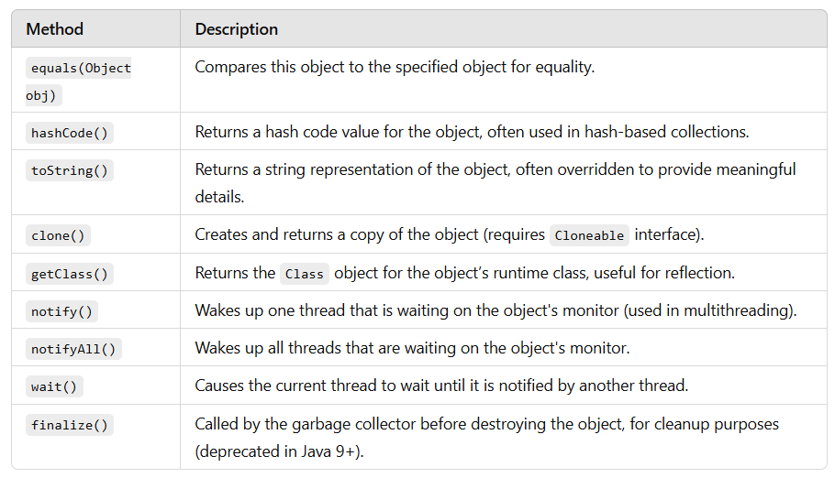

Slide 12
Object cloning
In Java, object cloning is the process of creating an exact copy of an existing object.
It is commonly used when you want to duplicate an object with the same values but not affect the original object when modifying the clone.
Java provides the clone() method for object cloning, which is defined in the Object class and creates a shallow copy of an object by default.
To perform cloning, a class must:
Implement the Cloneable interface.
Override the clone() method.

Slide 13
Types of Cloning
Shallow Cloning:
Only the top-level object is duplicated, and its references still point to the original objects.
Deep Cloning:
Both the top-level object and all objects referenced by it are duplicated, meaning changes to cloned objects don't affect the original.

Slide 14
Example of shallow copy
class Address {
String city;
Address(String city) {
this.city = city;
}
}
class Person implements Cloneable {
String name;
Address ;
Person(String name, Address address) {
this.name = name;
this.address = address;
}
@Override
protected Object clone() throws CloneNotSupportedException {
return super.clone();
}
public static void main(String[] args) {
try {
Address = new Address("Pune");
Person original = new Person("Pranali", address);
Person clone = (Person) original.clone();
// Changing clone’s address
clone.address.city = "Mumbai";
System.out.println("Original's City: " + original.address.city); // Output: Mumbai
System.out.println("Clone's City: " + clone.address.city); // Output: Mumbai
} catch (CloneNotSupportedException e) {
e.printStackTrace();
}
}
}

Slide 15
Example of Deep copy
class Address implements Cloneable {
String city;
Address(String city) {
this.city = city;
}
protected Object clone() throws CloneNotSupportedException {
return super.clone();
} }
class Person implements Cloneable {
String name;
Address ;
Person(String name, Address address) {
this.name = name;
this.address = address; }
protected Object clone() throws CloneNotSupportedException {
Person clonedPerson = (Person) super.clone();
clonedPerson.address = (Address) address.clone(); // Clone the Address as well
return clonedPerson;
}
public static void main(String[] args) {
try {
Address address = new Address("Pune");
Person original = new Person("Pranali", address);
Person clone = (Person) original.clone();
// Changing clone’s address
clone.address.city = "Mumbai";
System.out.println("Original's City: " + original.address.city); // Output: Pune
System.out.println("Clone's City: " + clone.address.city); // Output: Mumbai
} catch (CloneNotSupportedException e) {
e.printStackTrace();
}
}
}

